Slide 1

ECE 5159
DIGITAL SYSTEM DESIGN WITH VHDL
Engr. Professor Alice Oluwafunke Oke
Department of Computer Engineering, ACU, Oyo

Slide 2
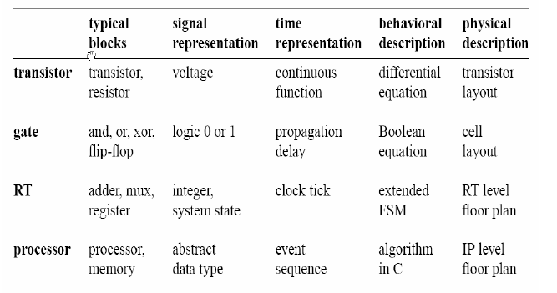
DIGITAL SYSTEM DESIGN
LEVELS OF ABSTRACTION OF DIGITAL SYSTEM

Slide 3
DIGITAL SYSTEM DESIGN
Developing a digital system is a refining and validating process
Main tasks Consist:
Synthesis
Physical design
Verification
Testing

Slide 4
SYNTHESIS
Synthesis is the process of generating a logic circuit from the description of the desired functional behaviour of a digital system
Steps of the Synthesis:
Create a Truth Table
Generate SOP/POS expression
Optimize the expression
Design the logic circuit

Slide 5
SYNTHESIS Contd
When designing a logic circuits, the designer works from two sets of known values that are used to create a table
Various states that the inputs to the logical network may assume
The desired outputs for each input combination or valuation.

Slide 6
LOGICAL EXPRESSION
Logical expression can be in two forms:
Sum of Product (SOP)
Examples:
1. XYZ + WYZ + XWG
2. ABD + CBA + BDC
Product of Sum(POS).
Examples:
1. (X +Y) (Z+W) X
2. (A+C) (B+D) (B+C) (A+D+E)

Slide 7
Generating Logical Expression
1. Create a Truth Table
A minterm is also
referred to as Product term
Each of the variables appear once in a minterm
The variable may appear in complemented or uncomplemented form
Minterm is X if X =1 and X if X =0
X | Y | Z | F | Pdt terms (Minterms) | Sum terms (Maxterms)
0 | 0 | 0 | 0 | X Y Z | X + Y + Z
0 | 0 | 1 | 0 | X Y Z | X + Y + Z
0 | 1 | 0 | 1 | X Y Z | X + Y + Z
0 | 1 | 1 | 1 | X Y Z | X + Y + Z
1 | 0 | 0 | 0 | X Y Z | X + Y + Z
1 | 0 | 1 | 0 | X Y Z | X + Y + Z
1 | 1 | 0 | 1 | X Y Z | X + Y + Z
1 | 1 | 1 | 0 | X Y Z | X + Y + Z

Slide 8
Generating Logical Expression Contd
SOP Generation
POS Generation
A maxterm is also
referred to as a Sum
term
It has the same characteristics as Minterm except that
Maxterm is X if X =0 and X if X =1
A function can be represented in SOP by ORing the minterms corresponding to high outputs i.e XYZ = 1
A function can be represented in POS by ANDing the maxterms corresponding to low outputs i.e XYZ = 0

Slide 9
Generating Logical Expression Contd
2. Generate SOP/POS
SOP Expression for F output on the previous table is
F =XYZ+XYZ+XYZ,
POS Expression for F output on the previous table is
F =(X+Y+Z) (X+Y+Z) (X+Y+Z) (X+Y+Z)(X+Y+Z)

Slide 10
Optimization of Logical Expression
3. Optimize SOP Expression
F =XYZ+XYZ+XYZ,
=XY(Z+Z)+XYZ
=XY+XYZ
=XY(Z+1)+XYZ
=XYZ+XY+XYZ
=YZ(X+X)+XY
=XY+YZ
Optimize POS Expression
F=(X+Y+Z) (X+Y+Z) (X+Y+Z) (X+Y+Z)(X+Y+Z) =(X+Y)(X+Y)(X+Y+Z) =Y(X+Y+Z)
= XY+YY+YZ
= XY+YZ
= Y(X+Z)
This Optimization technique is also known as algebraic technique
It is simply one of the techniques for optimization
Another optimization technique is Kmap

Slide 11
Generating Logical Expression Contd
4. Design the logic circuit
X
X Y
Y
Y Z + X Y
POS logic circuit
Z
Y Z
X
X + Z
SOP logic circuit
Z
Y(X + Z)
Y

Slide 12
DESIGN EXAMPLE
A Three-way light control
Assume that a large room has three doors and that a switch near each door controls a light in the room. The switch is turn on or off by changing the state of any one of the switches according to the following condition:
The light is off if all switches are open
Closing any of the switches turn the light on,
Turning on a second switch turn the light off
The light will be on if exactly one switch is closed and off if two (or no) switches are closed.
If the light is off when two switches are closed, then it should be turned on by closing the third switch

Slide 13
Solution
Truth Table
X₁ | X₂ | X₃ | F
0 | 0 | 0 | 0
0 | 0 | 1 | 1
0 | 1 | 0 | 1
0 | 1 | 1 | 0
1 | 0 | 0 | 1
1 | 0 | 1 | 0
1 | 1 | 0 | 0
1 | 1 | 1 | 1

Slide 14
Solution
Truth Table
SOP Expression
X₁ | X₂ | X₃ | F
0 | 0 | 0 | 0
0 | 0 | 1 | 1
0 | 1 | 0 | 1
0 | 1 | 1 | 0
1 | 0 | 0 | 1
1 | 0 | 1 | 0
1 | 1 | 0 | 0
1 | 1 | 1 | 1
F =m₁+m₂+m₄+m₇
K-map Optimization
X₁ X₂
X₁ X₂
X₁ X₂
X₁ X₂
X₃
1
1
X₃
1
1

Slide 15
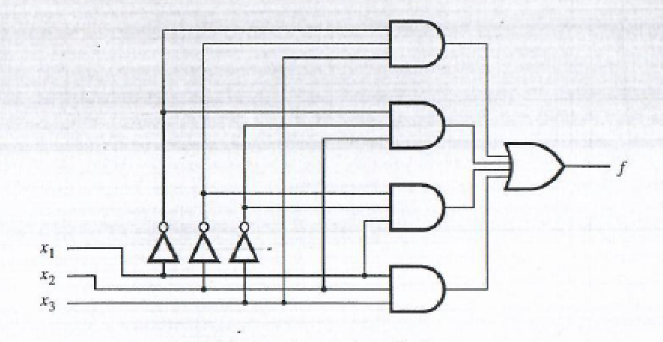
Solution Contd
A Three-way light control

Slide 16
ASSIGNMENT 2
Generate the POS expression and optimization, Kmap optimization and final synthesis of the Design example

